Slide 1

MUHAMMAD FAKHRUL HADI BIN NORAINI A18CS0136
MUHAMMAD AIMAN HAKIM BIN AHMAD RIDZO A18CS0121
AHMAD SYAKIR BIN ZAIDI A18CS0018

Slide 2
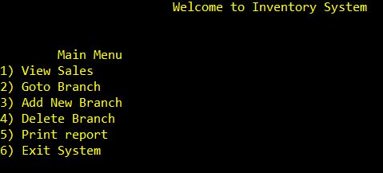
PROGRAM

Slide 3
Our project is about inventory system for a shop in the mall. The shop is selling clothes like shirt, jeans and many more.
In our menu, we give some choices to user to do the task that they want. We give six choices like views sales, go to branch, add new branch, delete branch, print report and exit system.
First we want to explain about first choices, view sales. If user choose this choice, all the sales that have made listed on the output.
Then, the go to branch choice, the user need to enter the branch code to do the work only on the selected branch. After that, the system ask user what they want to do with the branch. User can add and delete an item, sale the item, display all items that have at the branch and exit. User need to enter the item category, code and price id they want to add or delete item. In sale item, if the item was sold, the item in the branch will reduce by how much that they have sold. Display all item just display the item that they have only.
For add and delete branch, the user or owner can add or remove the branch that want to sponsor them items.
Lastly, print report selection is to print all report about items and all selection above what the user or owner have done with it.

Slide 4
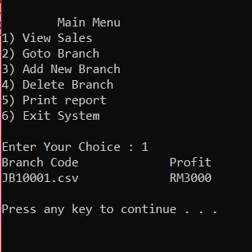
First we want to explain about first choices, view sales. If user choose this choice, all the sales that have made listed on the output.

Slide 5
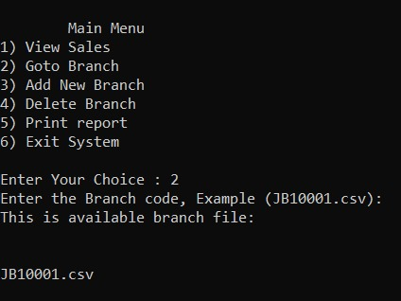
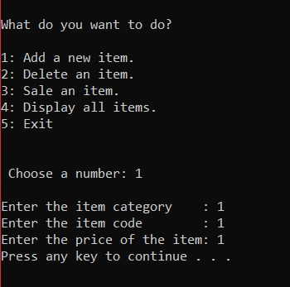
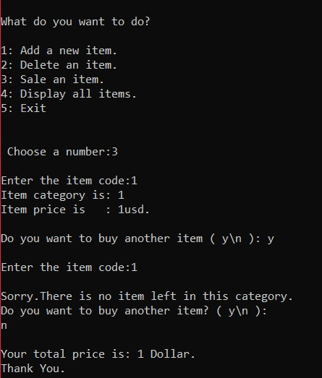
Then, the go to branch choice, the user need to enter the branch code to do the work only on the selected branch. After that, the system ask user what they want to do with the branch. User can add and delete an item, sale the item, display all items that have at the branch and exit. User need to enter the item category, code and price id they want to add or delete item. In sale item, if the item was sold, the item in the branch will reduce by how much that they have sold. Display all item just display the item that they have only.
“Go to branch” menu
Add items
Sale items

Slide 6
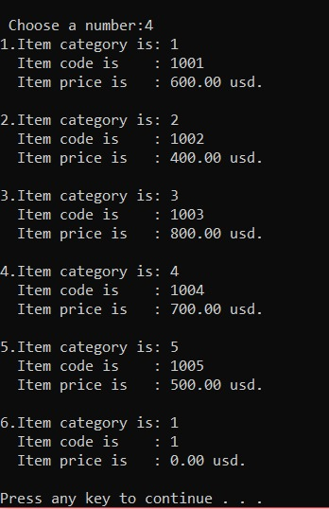
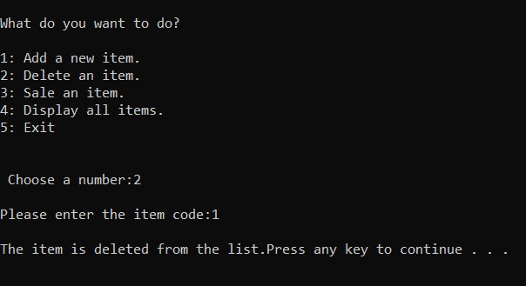
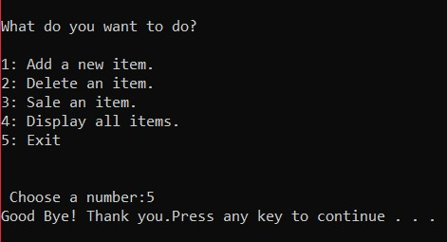
Delete items
Display all items
Exit “go to branch” menu

Slide 7
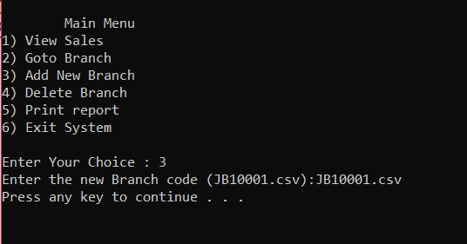
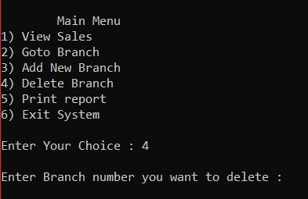
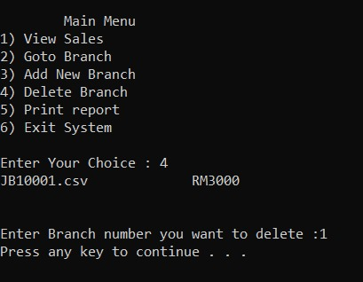
For add and delete branch, the user or owner can add or remove the branch that want to sponsor them items.
Add branch
Delete branch

Slide 8
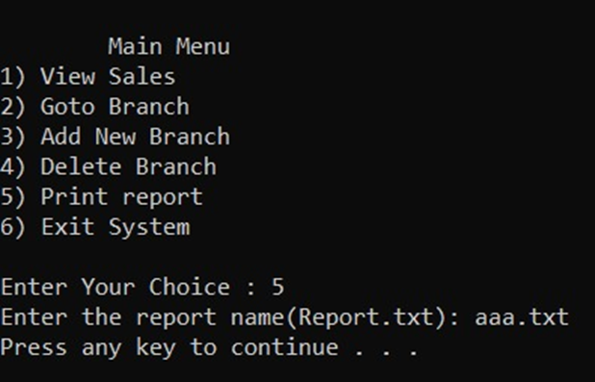
Lastly, print report selection is to print all report about items and all selection above what the user or owner have done with it.

